Slide 1
Intro to MHS GENESIS Town Hall
25 APR 2023

Slide 2
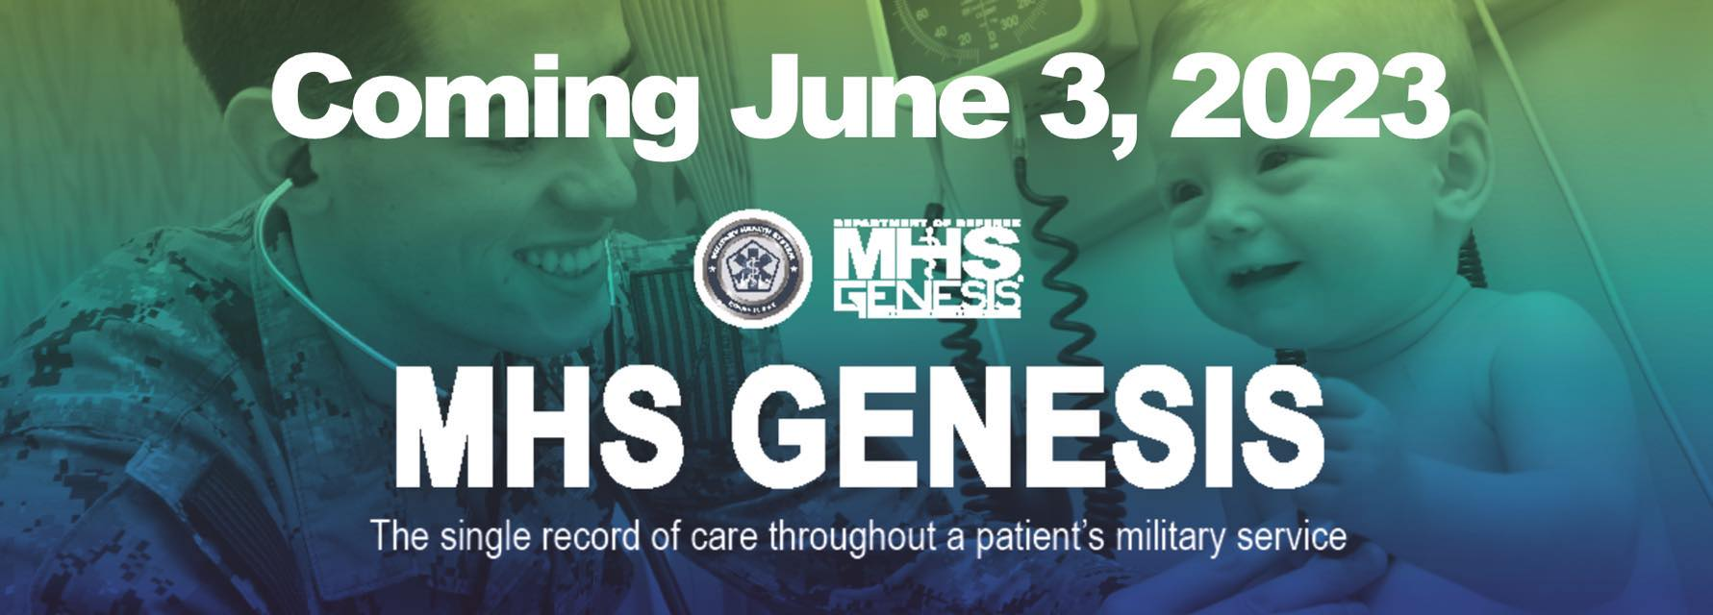
What is MHS GENESIS ?
MHS GENESIS is the Military Health System's new electronic health record. When fully deployed, MHS GENESIS will provide a single health record for service members, veterans, and their families.
The MHS GENESIS Patient Portal is a secure website for 24/7 access to your health information, including managing appointments and exchanging messages with your care team. The new patient portal is launching at sites as MHS GENESIS deploys, replacing the TRICARE Online Secure Patient Portal.

Slide 3
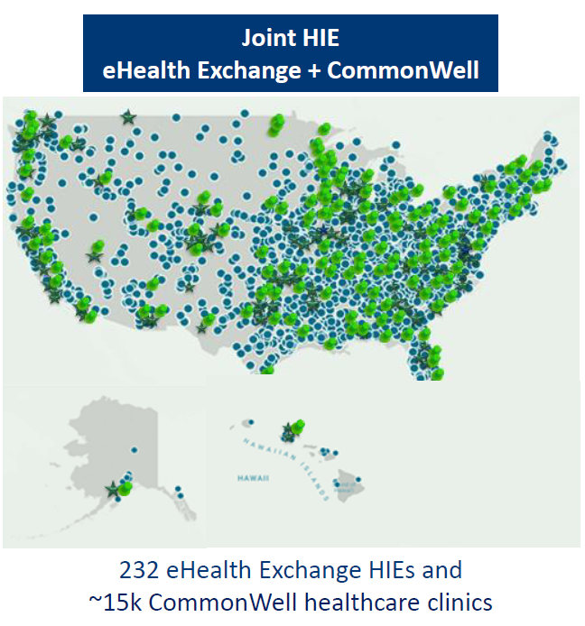
What are some of the Benefits ?
One Integrated EHR System
From basic training to retirement, and into the VA – it’s the same record
Records travel to next duty station (no more paper records)
Same EHR with all services and at all bases
Access to Joint Health Information Exchanges (sharing of medical information with select civilian providers)
Patient Portal
24/7 Access to your Electronic Health Record
Exchange Secure Messaging with your care team
Prescription renewals for prescriptions that are out of refills
Make On-Line Appointments
View laboratory and test results
Fill out forms on Clipboard
Research health information on Health Library
Joint Health Information Exchanges
Joint Longitudinal Viewer (access to Legacy medical document for providers)
Notes:
CPT West
The old records are not going away. We still have those. Same for paper records.
However, TOL PP encounter notes will need to be downloaded if you want to maintain that information for yourself.

Slide 4
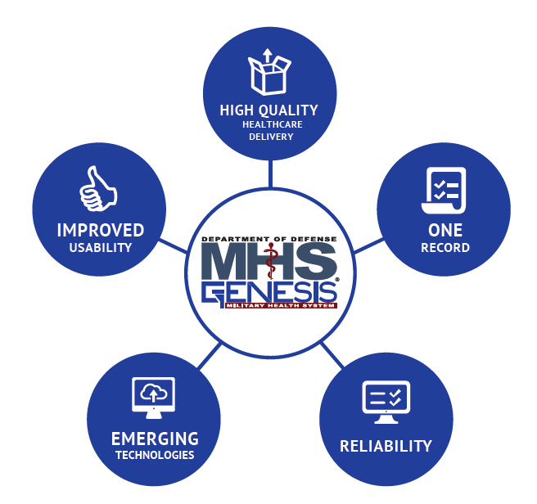
What MHS GENESIS Brings to Beneficiary
MHS GENESIS will replace a myriad of legacy healthcare systems
MHS GENESIS supports the availability of electronic health records for more than 9.6 million potential DoD beneficiaries, and 205,000 Military Health System personnel globally
MHS GENESIS creates a standardized system of care across the entire Military Health System
MHS GENESIS has been deploying via a wave model that began in the Pacific Northwest in 2017, and will continue through December 2023.

Slide 5
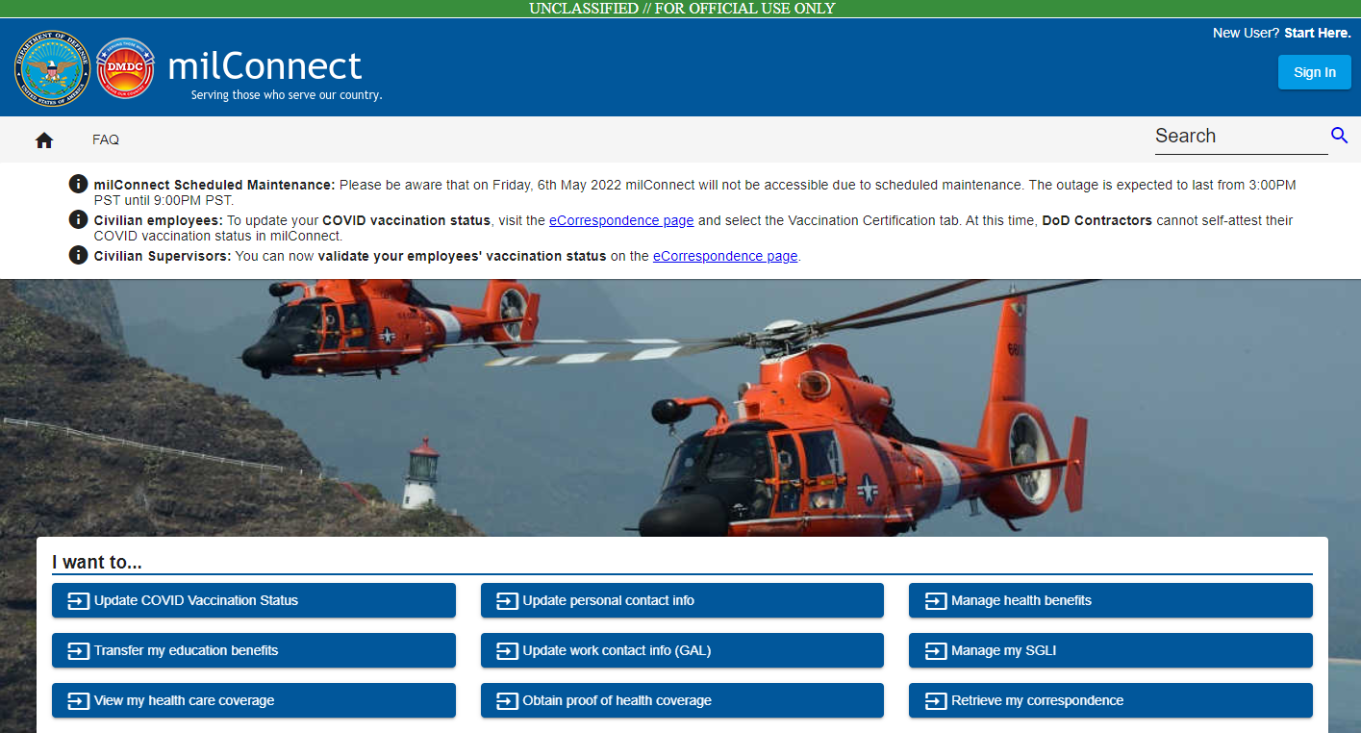
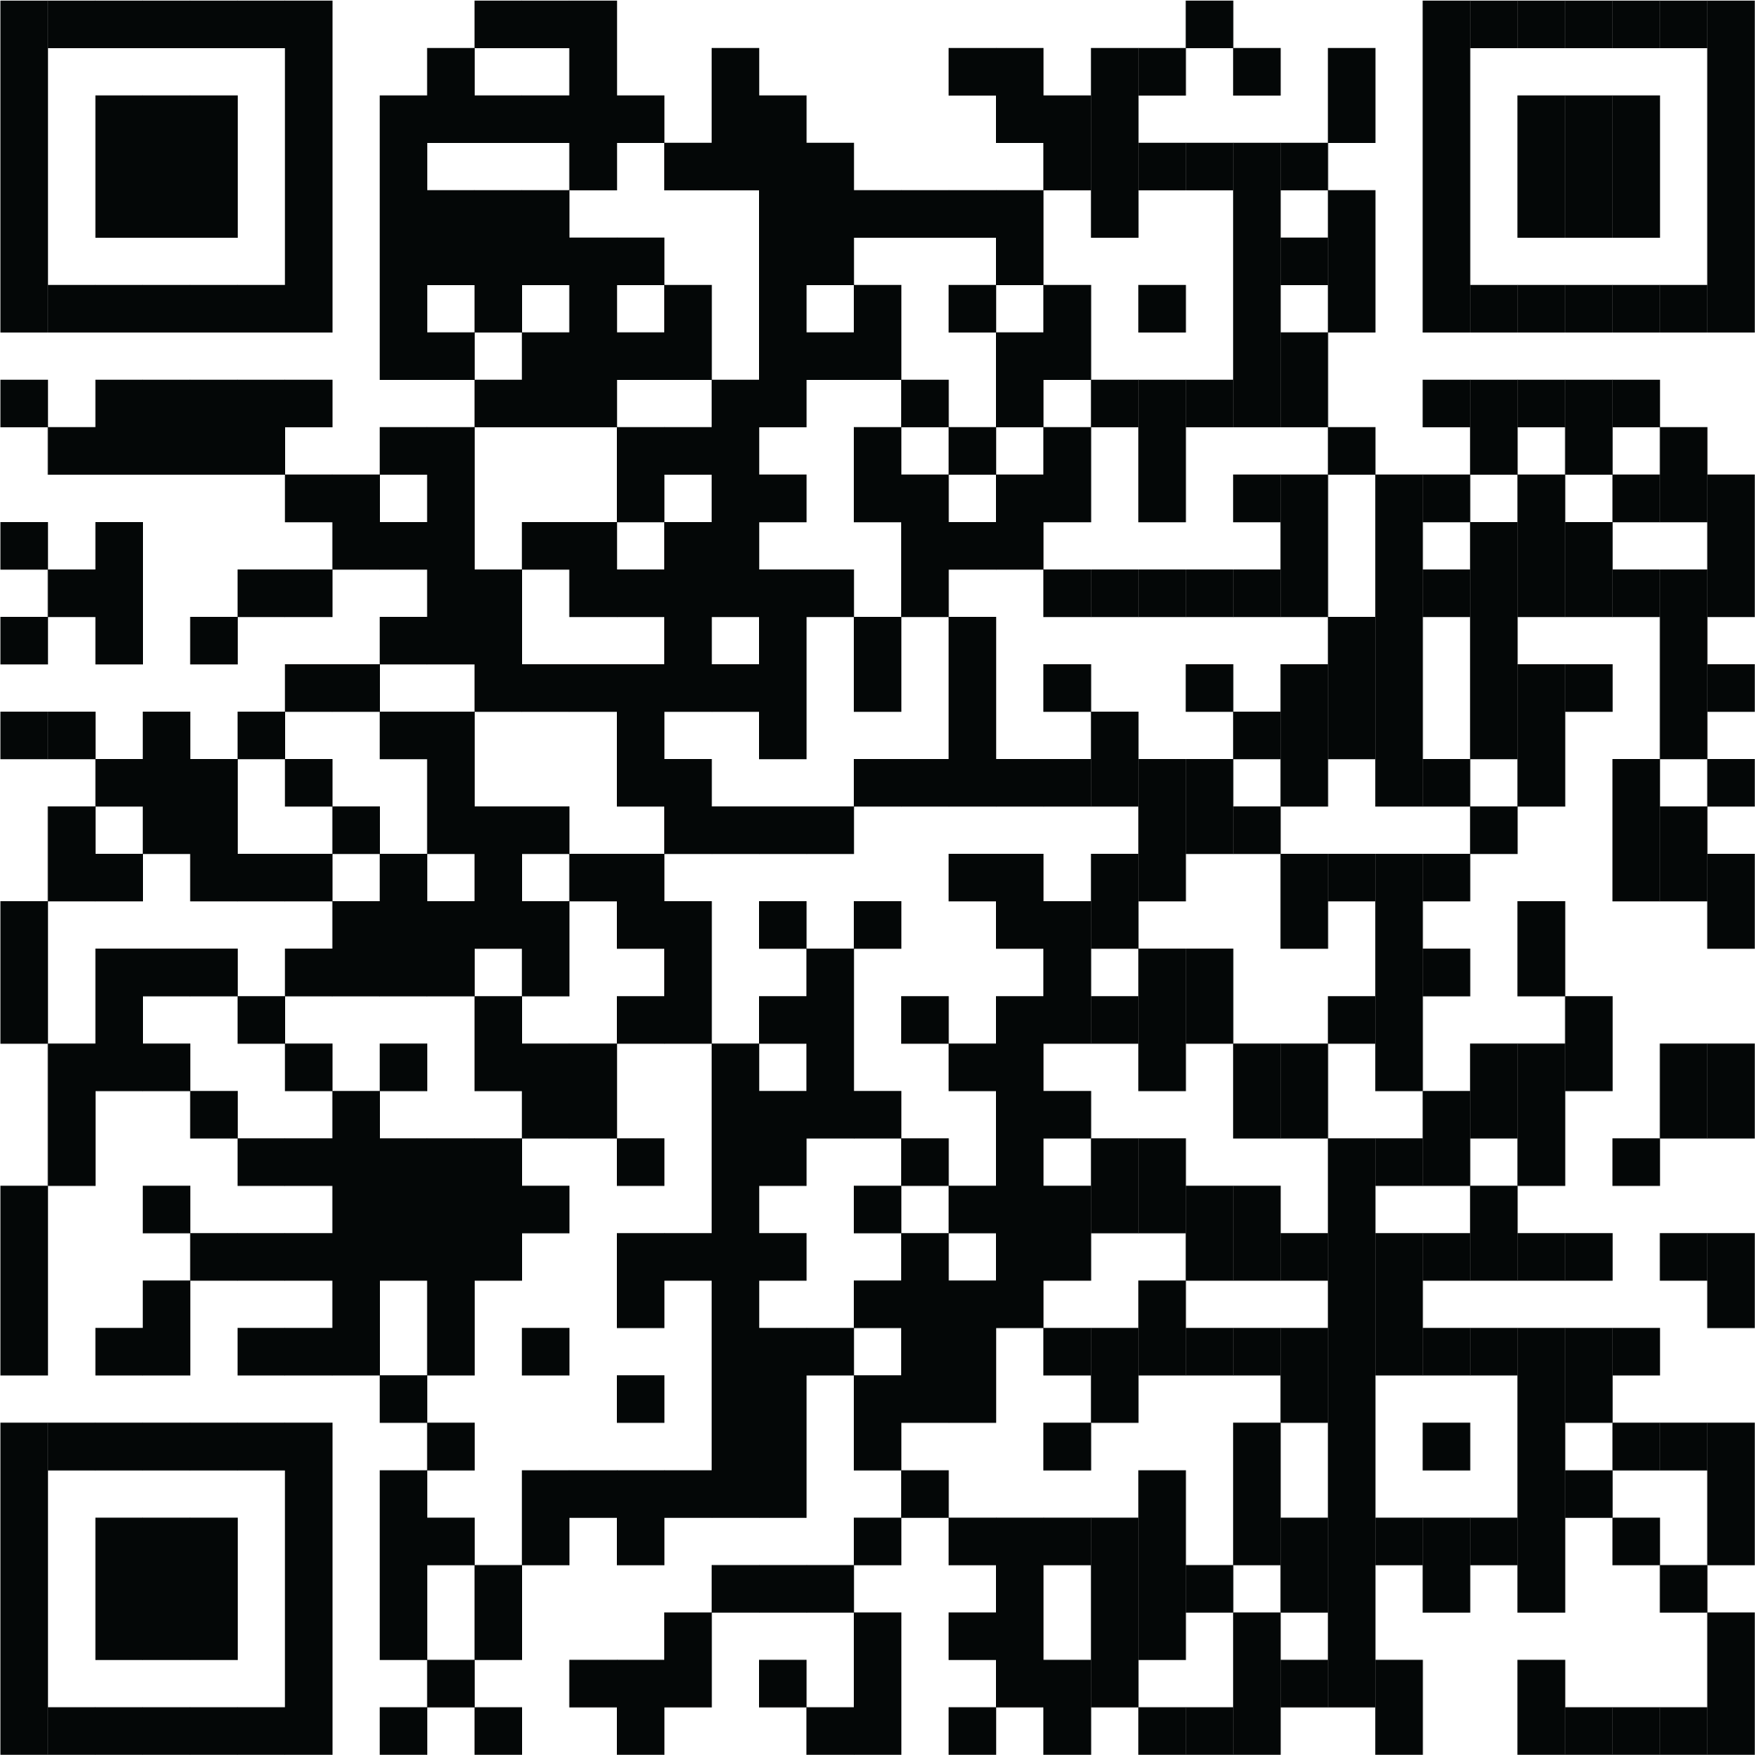
As a Beneficiary, what do I have to do ?
Need to update their DEERS
(Defense Enrollment Eligibility Reporting System)
Update DEERS
Ensure EMAIL is current
Ensure PHONE NUMBER is correct
Ensure dependents are correct
Check all other information
Current Duty Station
Notes:
DS logon is owned by DMDC, not the clinic. If you have questions their FAQ sheet most likely has the answer.

Slide 6
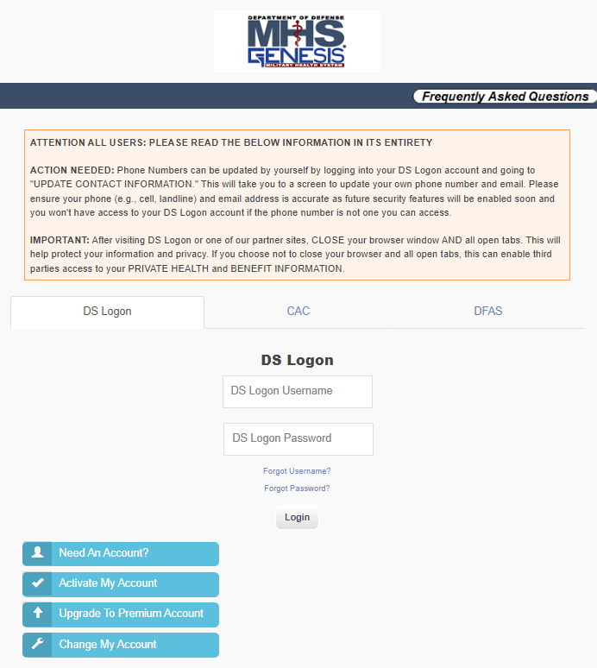
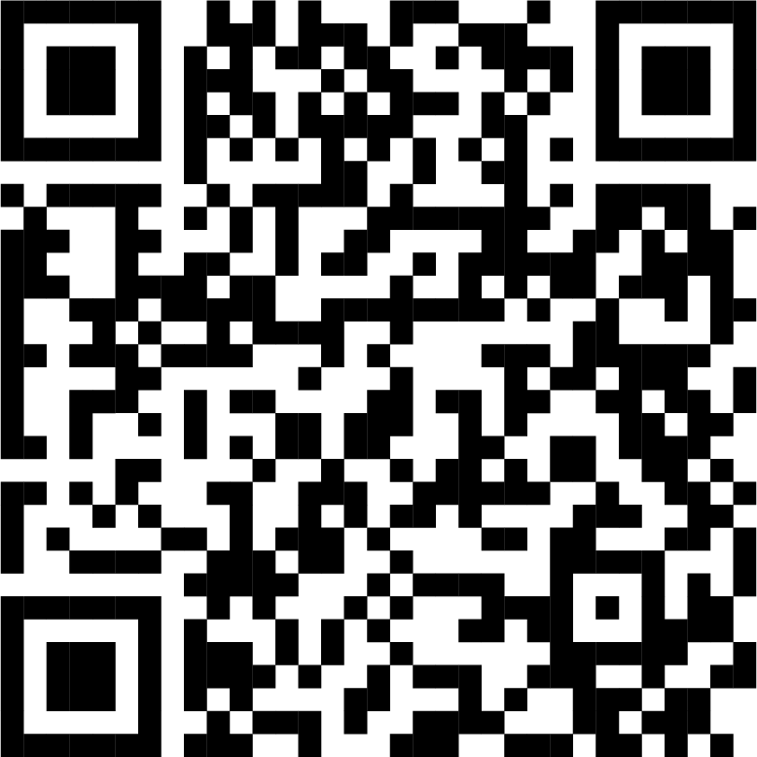
As a Beneficiary, what do I have to do ?
Need to ensure beneficiaries 18+ years old has a DS Logon Account
https://myaccess.dmdc.osd.mil/identitymanagement/authenticate.do?execution=e1s1
Create DS Logon Account

Slide 7
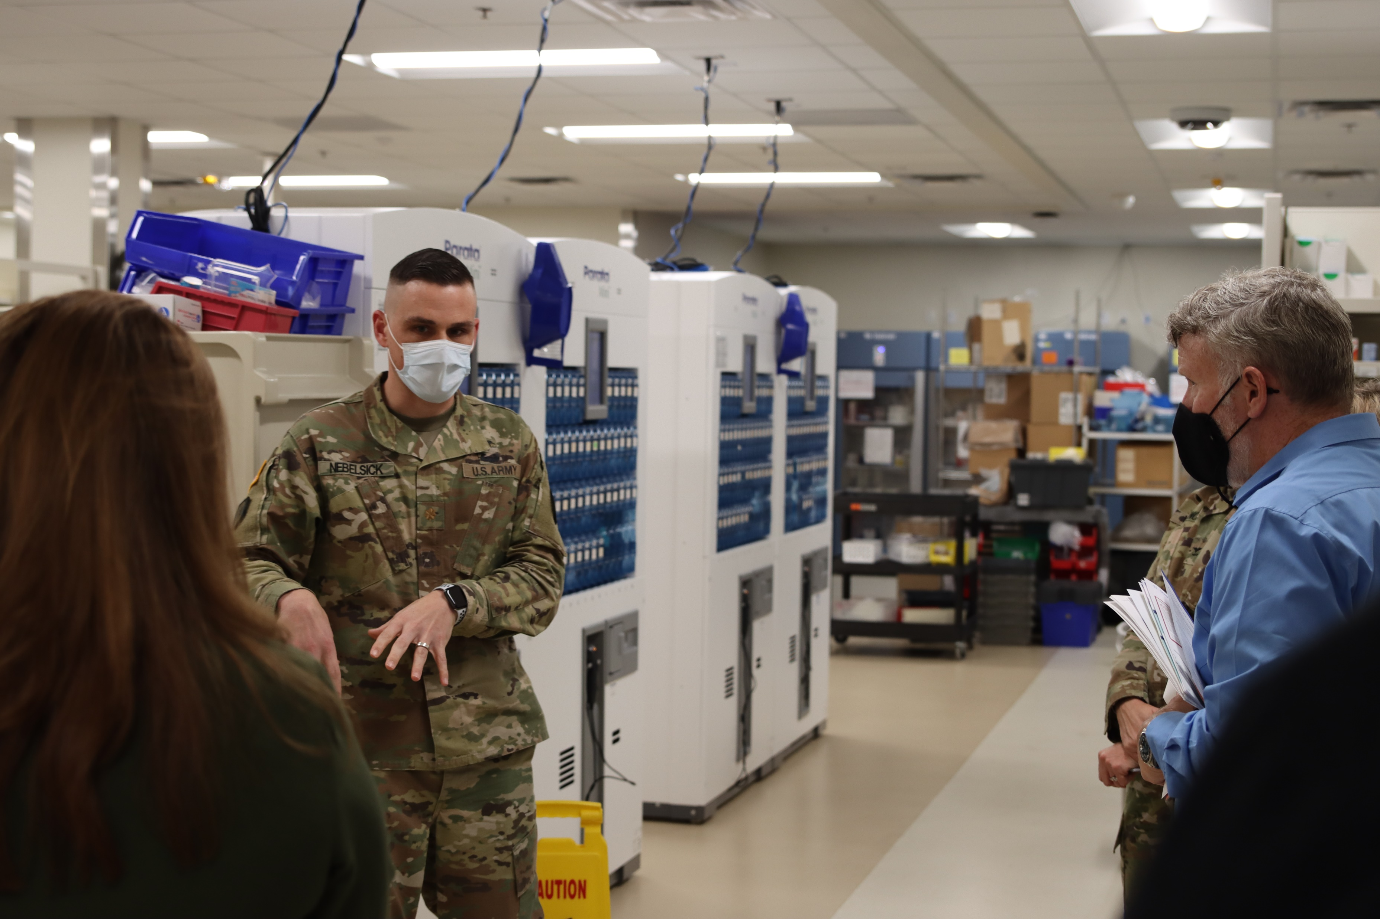
How have we been preparing?
To prepare for the transition our staff has been hard at work:
Workflow analysis
Online and in-person training
Learning labs
Mock Go-Live
Soft Go-Live with minimal patients to test the systems

Slide 8
As a Beneficiary, what will the Impacts be?
Challenges until we get back to our baseline ---
Appointments will be affected April through July:
Less Appointments Available Starting Now
Limitation on types of appointments booked
Longer wait times for routine appointments
Duration of patient/provider appointments may be longer
Beneficiaries may have to seek health care through the TRICARE network
Less military-specific appointments (flight-physicals, school physicals, end-of-service physicals, etc.)
Technical issues w/ understanding a new system
TOL Patient Portal APPOINTING ability
Turns off ONE week (7 days) prior to MHS GENESIS Go-Live
May 27, 2023
MHS Genesis patient portal appointment ability won’t be available for some time
Notes:
PCMH: Appointments will decrease 10th when user training starts, and will continue throughout the process towards June 3rd. 50% by middle of May.
REHAB: Appointments will decrease 10th when user training starts, and will continue throughout the process towards June 3rd. 50% by middle of May.
DBH: Appointments will decrease 10th when user training starts, and will continue throughout the process towards June 3rd. 50% by middle of May.
The bookings will basically be 50% throughout April into May before the template because of staffing and training.
Appointment tool not available but can use secure messaging. However, expectation on Secure Messaging replies may take longer.
Reiterate the uses for walk-in appointments. Specifically in regard to the different clinics.
MAJ Pinger Brief (Dr. Johnson, Mr. Hurst as panelists)

Slide 9
How to Access the Network for Care
For emergency services:
Please go to the nearest hospital emergency room or dial 911. Closest ERs to Fort Knox are Baptist Health in Elizabethtown and University of Louisville or Norton in Louisville.
Call the Nurse Advice Line: 800-874-2273, Option1
The Nurse Advice Line can triage and assist with getting appropriate care, schedule appointments, and submit referrals for urgent care needs.
Visit a TRICARE network urgent care center
TRICARE-eligible dependents can use a network urgent care center. Please note that active-duty service members will require a referral for both virtual and network urgent care and mental health visits.
Access virtual urgent care with Doctor on Demand or Telemynd
TRICARE beneficiaries can use Doctor on Demand or Telemynd. Doctor on Demand is a 24-hour virtual urgent care with access to doctors and mental health specialists. Please note that active-duty service members will require a referral.
Utilize Clinical Preventive Services covered by TRICARE without a referral from your PCM
TRICARE covers clinical preventives services that don’t require a referral from your PCM including:
*Breast Exams/Mammograms *Immunizations *Infectious Disease Screenings *Physicals *Well-Child Exams (under 6)
*Overseas Family Member Physicals *School Physicals *Well Woman Exams
Notes:
For a list of the nearest civilian ERs to Fort Knox visit: www.goperspecta.com/VPD/HumanaMilitary/
To locate an urgent care center near you visit www.goperspecta.com/VPD/HumanaMilitary/public/ProviderSearch/Main
public/ProviderSearch/Main
. Download the app or go to doctorondemand.com. Telemynd provides virtual mental health care, matching you with a therapist or prescriber covered by TRICARE at https://www.telemynd.com
*More information at: https://tricare.mil/HealthWellness/Preventive

Slide 10
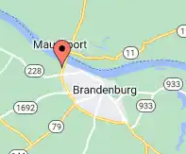
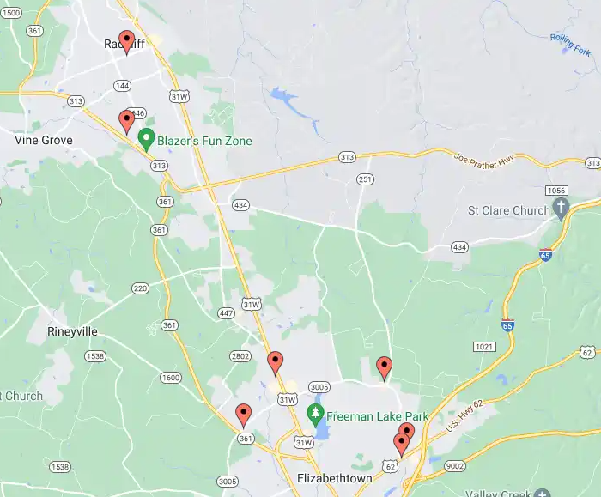
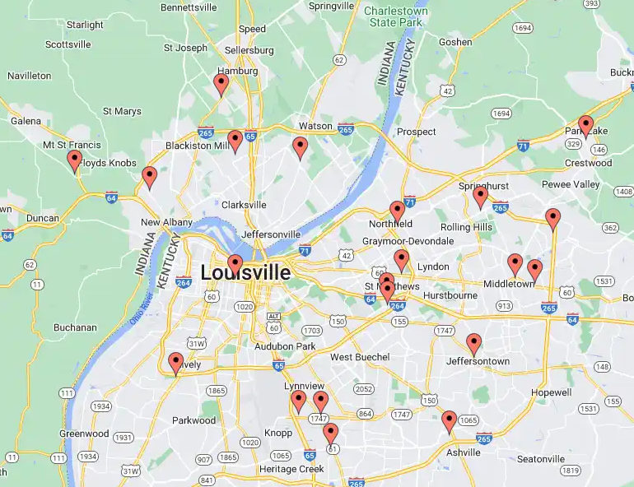
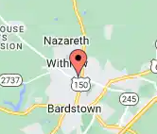
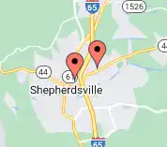
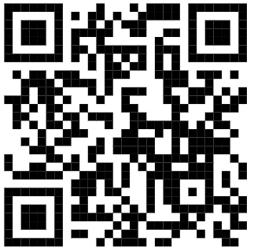
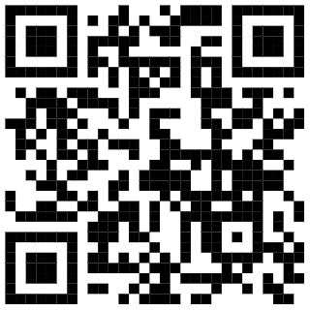
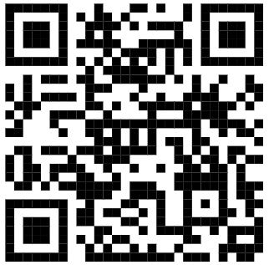
Tricare Network Urgent Care Clinics
Map of Tricare Network UCCs
List of Tricare Network UCCs
Humana Provider Search Tool

Slide 11
Referrals & Pre-Authorizations
What plan are you using? | Need a referral? | Need pre-authorization? | When do I not need a referral?
TRICARE Prime (Active Duty service member) | Yes, for any care your PCM doesn't provide (urgent, routine, preventive, and specialty care) Your PCM works with your regional contractor for the referral. If you get care without a referral, you’ll pay out-of-pocket. Enrolled in TRICARE Prime Remote? Referrals come from your assigned network PCM | Yes, for all urgent, routine, preventive, and specialty care. Your PCM submits a referral and Humana submits the pre-authorization for care. | Always need a referral/pre-authorization unless it is for Emergency Room Care.
TRICARE Prime (all beneficiaries except Active Duty service members) | Yes, for specialty care and some diagnostic services. Your PCM works with your regional contractor for the referral. If you see a specialist without a referral, you’ll pay out of pocket. Enrolled in TRICARE Prime Remote? Referrals come from your assigned network PCM | Yes, for all specialty care. Your PCM submits a referral and Humana submits the pre-authorization for care. | You can get the following services from a TRICARE network provider in your region without a PCM referral. 1. Preventive services 2. Outpatient mental health care visits If you get care from a non-network provider (or a network provider outside of your region) without a referral from your PCM, you're using the point-of service-option, resulting in higher out-of-pocket costs.
Notes:
Referral – Request for care from your PCM for any care they cannot provide
Pre-Authorization – Regional Tricare Contractor (in our case Humana Military) authorizes you to receive that care and assigns the care to a Tricare Network Provider

Slide 12
Helpful Websites to Find Care
For a list of the nearest civilian ERs to Fort Knox visit: www.goperspecta.com/VPD/HumanaMilitary/
To locate an urgent care center near you visit www.goperspecta.com/VPD/HumanaMilitary/public/ProviderSearch/Main
public/ProviderSearch/Main
To access Doctor on Demand download the app or go to doctorondemand.com.
Telemynd provides virtual mental health care, matching you with a therapist or prescriber covered by TRICARE at https://www.telemynd.com
*More information for Tricare covered services at: https://tricare.mil/HealthWellness/Preventive

Slide 13
As a Beneficiary, what will the Impacts be?
Pharmacy
After June 3rd, 2023, our service and wait times will be much longer, especially in the first 4-6 weeks.
We encourage all beneficiaries to process and pick up prescriptions at our pharmacies that are due to be filled prior to June 3rd to the maximum extent possible.
In the new system we will be able to accept electronic prescriptions for all medications, including DEA Schedule II-V controlled substances.
There will no longer be a need to transfer prescriptions between military pharmacies that are both using MHS GENESIS. For beneficiaries that are on TDY, vacation, or PCS to another military installation, all active prescriptions with fills remaining can be processed at any military pharmacy that is using MHS GENESIS.
Notes:
MAJ Nebelsick Brief
Pharmacies will transition to a new electronic health record system, MHS GENESIS. Our new system will allow us to improve our ability to provide pharmacy services in alignment with the TRICARE Pharmacy prescription benefit and other points of pharmacy service such as retail pharmacies and Express Scripts Home Delivery. As we prepare for this transition there are a few things we want all of our beneficiaries to know that we believe will help minimize frustrations and make this change along with us as efficiently as possible.
After June 3rd, 2023, our service and wait times will be much longer, especially in the first 4-6 weeks. Please understand that our staff will be learning new steps and processes, and we expect to get more efficient with time. We ask that you please remain patient with us as we learn and work to ensure we continue providing safe, reliable pharmacy services with the goal of eventually reducing our service times as best as we can.
We encourage all beneficiaries to process and pick up prescriptions at our pharmacies that are due to be filled prior to June 3rd to the maximum extent possible. This will help to minimize the extended waits and service times after we are live with the new system.
MHS GENESIS also provides a few important improvements that will allow us to provide better services to our pharmacy beneficiaries.
In the new system we will be able to accept electronic prescriptions for all medications, including DEA Schedule II-V controlled substances. Handwritten prescriptions will no longer be required from off-post prescribers, and electronically transmitted prescriptions will be the preferred method of delivery to our pharmacies.
There will no longer be a need to transfer prescriptions between military pharmacies that are both using MHS GENESIS. For beneficiaries that are on TDY, vacation, or PCS to another military installation, all active prescriptions with fills remaining can be processed at any military pharmacy that is using MHS GENESIS.
Unfortunately, one of the additional changes with MHS GENESIS is the inability to request prescription refills to the pharmacy online. After June 3rd, all prescription refills must be called in to our pharmacies using the automated AudioCare refill call-in system with the phone number listed on our prescription labels. The MHS GENESIS Patient Portal is not yet able to transmit online refill request to our pharmacies for prescriptions that have refills remaining. It is important to distinguish that prescription renewals for prescriptions that have no refills remaining can continue to be requested online using the MHS GENESIS Patient Portal, for patients enrolled at Ireland AHC.
For new or renewed prescriptions sent to us from the prescriber electronically, you can activate the prescription prior to visiting the pharmacy to ensure it is ready when you arrive at the pharmacy pickup windows and drastically reduce your wait time. Visit our website at https://ireland.tricare.mil, under “Health Services” then “Pharmacy” to download our online prescription request form or ask a pharmacy staff member at either of our pharmacies.
We hope this information will help prepare you for the upcoming changes and we are excited to bring this new system and features to our beneficiaries at Fort Knox Pharmacies.

Slide 14
As a Beneficiary, what will the Impacts be?
TOL Patient Portal Prescription Refills to Pharmacy
TOL Patient portal prescription refills to pharmacy turns off two (2) days prior to MHS GENESIS Go-Live (June 1, 2023)
After June 1st, all prescription refill requests to the pharmacy MUST be completed using the AudioCare phone system
There will be no online refill requests to pharmacy available
Initial Registration in the New System
MHS GENESIS should automatically register most IRAHC beneficiaries, however some system issues can occur
Any registration issues that need to be corrected should be identified on your first visit to IRAHC after June 3rd
If your first visit is to the pharmacy, there is a small chance you may be directed to IRAHC Outpatient Records to complete or correct registration prior to receiving your prescriptions.
IRAHC full registration hours are limited to 0800-1600
Notes:
MAJ Nebelsick Brief
Pharmacies will transition to a new electronic health record system, MHS GENESIS. Our new system will allow us to improve our ability to provide pharmacy services in alignment with the TRICARE Pharmacy prescription benefit and other points of pharmacy service such as retail pharmacies and Express Scripts Home Delivery. As we prepare for this transition there are a few things we want all of our beneficiaries to know that we believe will help minimize frustrations and make this change along with us as efficiently as possible.
After June 3rd, 2023, our service and wait times will be much longer, especially in the first 4-6 weeks. Please understand that our staff will be learning new steps and processes, and we expect to get more efficient with time. We ask that you please remain patient with us as we learn and work to ensure we continue providing safe, reliable pharmacy services with the goal of eventually reducing our service times as best as we can.
We encourage all beneficiaries to process and pick up prescriptions at our pharmacies that are due to be filled prior to June 3rd to the maximum extent possible. This will help to minimize the extended waits and service times after we are live with the new system.
MHS GENESIS also provides a few important improvements that will allow us to provide better services to our pharmacy beneficiaries.
In the new system we will be able to accept electronic prescriptions for all medications, including DEA Schedule II-V controlled substances. Handwritten prescriptions will no longer be required from off-post prescribers, and electronically transmitted prescriptions will be the preferred method of delivery to our pharmacies.
There will no longer be a need to transfer prescriptions between military pharmacies that are both using MHS GENESIS. For beneficiaries that are on TDY, vacation, or PCS to another military installation, all active prescriptions with fills remaining can be processed at any military pharmacy that is using MHS GENESIS.
Unfortunately, one of the additional changes with MHS GENESIS is the inability to request prescription refills to the pharmacy online. After June 3rd, all prescription refills must be called in to our pharmacies using the automated AudioCare refill call-in system with the phone number listed on our prescription labels. The MHS GENESIS Patient Portal is not yet able to transmit online refill request to our pharmacies for prescriptions that have refills remaining. It is important to distinguish that prescription renewals for prescriptions that have no refills remaining can continue to be requested online using the MHS GENESIS Patient Portal, for patients enrolled at Ireland AHC.
For new or renewed prescriptions sent to us from the prescriber electronically, you can activate the prescription prior to visiting the pharmacy to ensure it is ready when you arrive at the pharmacy pickup windows and drastically reduce your wait time. Visit our website at https://ireland.tricare.mil, under “Health Services” then “Pharmacy” to download our online prescription request form or ask a pharmacy staff member at either of our pharmacies.
We hope this information will help prepare you for the upcoming changes and we are excited to bring this new system and features to our beneficiaries at Fort Knox Pharmacies.

Slide 15
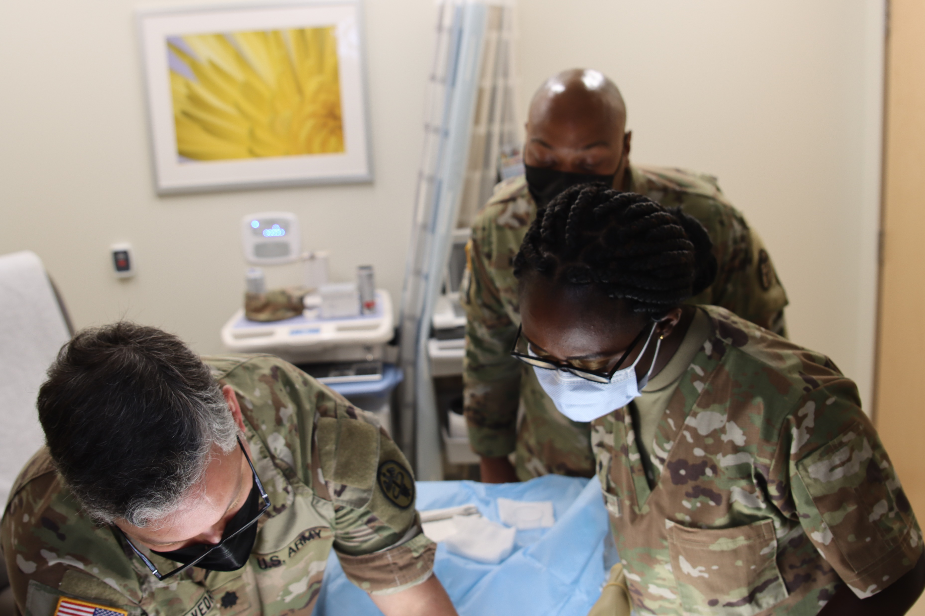
Post Go-Live Expectations
Technical issues with understanding a new system will result in:
Limited appointment availability (4-6 weeks)
Slow increase in available appointments
Longer check-in process
Longer wait times to pick up medication at the Pharmacy
Slower response times to Secure Messaging
System issues will occur throughout the Go-Live process
Notes:
50% appt availability until 2 weeks post go live and then increase in access from there. Delays in access can take up to 6 months to be back to baseline.

Slide 16
Patient Portal Eligibility
Ages 0-12: For beneficiaries between the ages of 0-12, the parents or guardians are granted access to their child’s Patient Portal account.
Ages 13-17: Beneficiaries between the ages of 13-17 do not have access until allowed by DS Logon.
Ages 18+: For beneficiaries ages 18 and up, access is available with a DS Logon Account.
Services members may continue to use their CAC

Slide 17
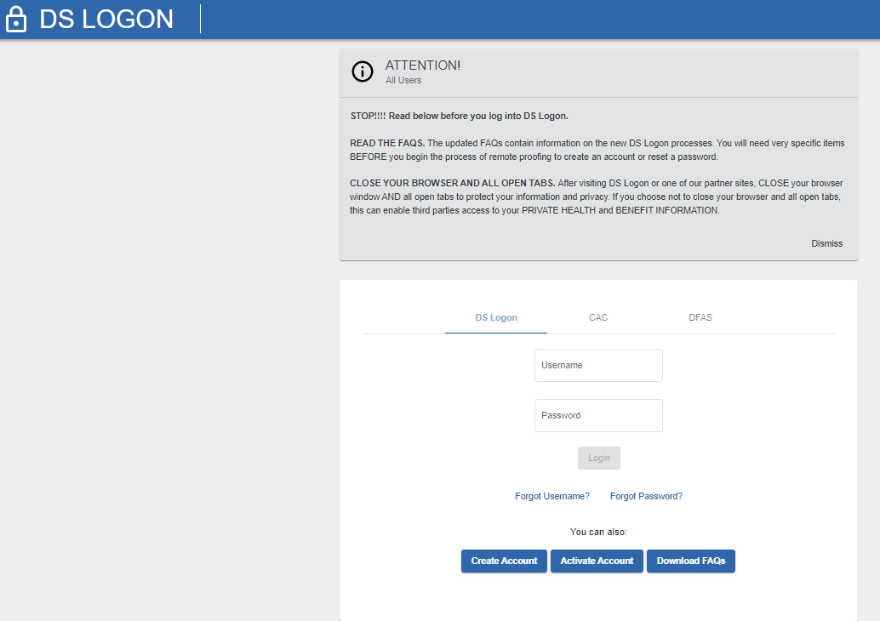
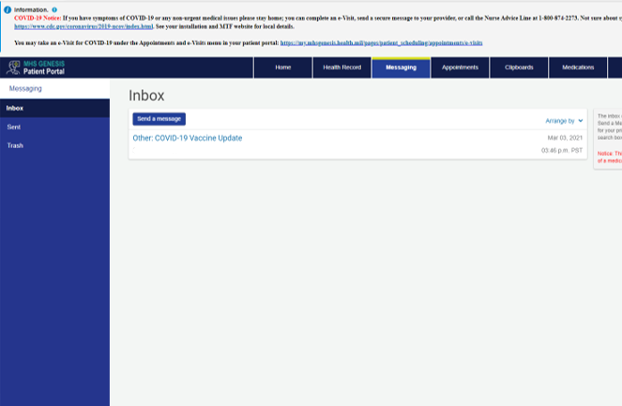
How do I access my EHR?
- Through the Patient Portal
https://myaccess.dmdc.osd.mil/identitymanagement/app/login
Two Ways to Access
DS Logon
CAC
First step: Create an Account
Notes:
CPT West

Slide 18
MHS GENESIS on Social Media
https://www.facebook.com/IrelandACH

Slide 19
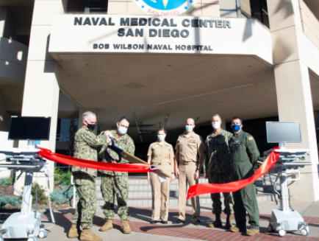
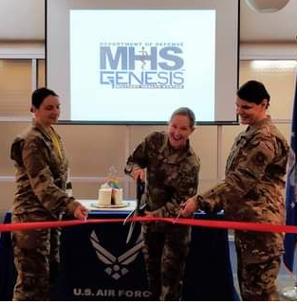
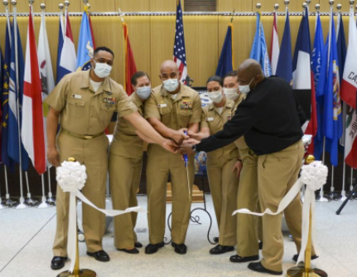
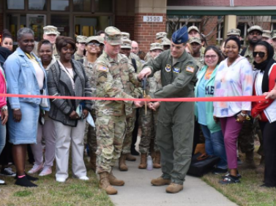
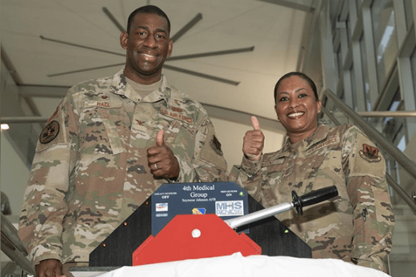
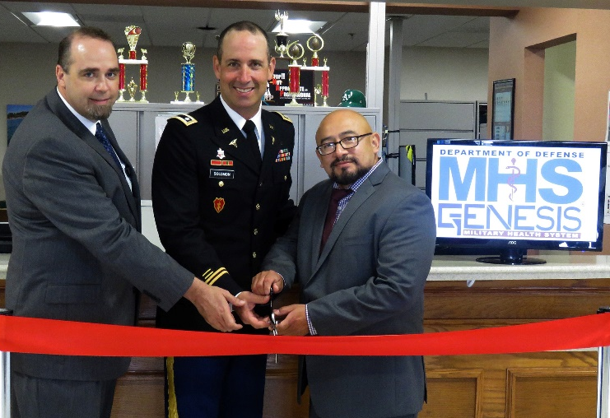
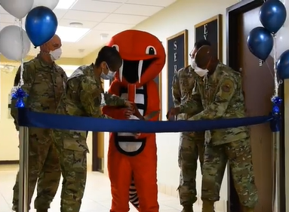
When do WE Go-Live !
Ireland Army Health Clinic
Go-Live: June 3, 2023

Slide 20
QUESTIONS ??

Slide 21
MHS GENESIS – QR Codes
MHS GENESIS @ Health.mil
DS Logon
https://www.health.mil/Military-Health-Topics/MHS-Transformation/MHS-GENESIS
https://myaccess.dmdc.osd.mil/identitymanagement/authenticate.do?execution=e1s1

